Slide 1
2026 Astrophysics SMEX
Quad Chart Guidelines and Sample

Slide 2
Investigation Name
PI: First, M. Last
Mission & Science Team:
Principal Investigator (PI): First, Last, Affiliation
Project Manager (PM): First, Last, Affiliation
Project Systems Engineer (PSE): First, Last, Affiliation
Deputy Principal Investigator (DPI): First, Last, Affiliation
Major Partners:
Organization A – Role(s)
Organization B – Role(s)
Organization C – Role(s)
...
Organization N – Role(s)
Insert graphic of the spacecraft concept with labels.
Insert graphic of the instrument complement with labels.
Mission: Brief introduction to the proposed mission.
Science Goals: Describe the science goals of the proposed investigation
Goal 1
Goal 2
Goal N
Baseline Mission: Summary of the mission measurements and how these address the science objectives of the investigation.
Threshold Mission: Describe any proposed descopes and the resulting investigation post descopes.
Instrument(s): Describe the instrument(s) characteristics. Include relevant specifications (e.g. TRL, type of instrument, sensor/detector size, FOV, focal length, spectral range, spectral/temporal/spatial sampling, frequency/wavelength, coatings, overall size, PSF, energy band)
Heritage:
Instrument or component: heritage mission.
Instrument or component: heritage mission.
Mission Details:
Launch Readiness Date: Day Month, Year; launch scenario number
Mission Duration: N months
Orbit: characteristics
Ground System Provider (SCaN or vendor name)
Flight Systems Details:
Spacecraft Bus manufacturer, model
Propulsion and method of control
Pointing Accuracy
Telecommunications link(s), total data volume per day
Mass/Power [Margins %]:
Dry Mass (Kg) MEV [% Margin]
Spacecraft Power (W) MEV [% Margin @ EOL]
FY26 Cost: Total PIMMC: $M (including $M UCR). Adjusted Cost Cap: $M.
Phases B-D, $M including $M (%) reserves, and $M contributions.
Phases E/F, $M including $M (%) reserves, $M contribution.
Schedule: N-mo Phases A-D, M-mo Phase E, X-mo Phase F, Z days of critical path FSR.
Descopes: (if any): Brief description (savings and milestones)

Slide 3

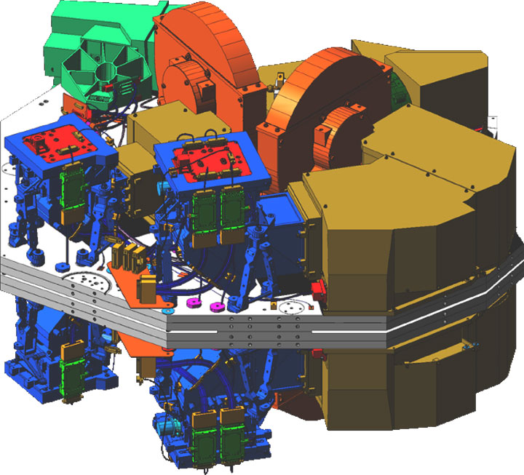
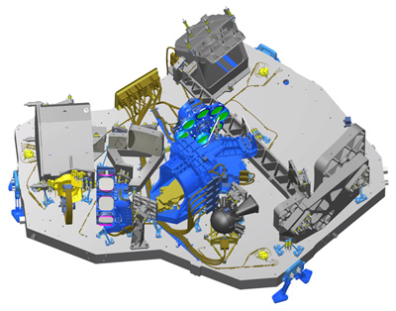
Stellar Observatory and Mapping Array (SOMA)
PI: Celeste L. Light
APSMEX26 SAMPLE
Observatory Assembly
Secondary Mirror
Primary Mirror
Pick-off Mirror
Filter Wheels
Mission & Science Team:
PI: Celeste L. Light, Society for Telescope Analysis and Retrieval (STAR)
PM: James Webb, STAR
PSE: John Young, STAR
DPI: Johannes Kepler, Galaga Institute
Major Partners:
STAR – PI, PM, PSE, SOC, Mission Assurance
Galaga Institute – DPI, Instrument Development
Qasar ‘R Us – Spacecraft, MOC
Sun shield
Filter wheel
Camera housing
Pick-off Mirrors
Bus
Focal Planes
NIRSpec
IFU
NIRCam
Mission: The Stellar Observatory and Mapping Array (SOMA) studies every phase in the history of our Universe, ranging from the first luminous glows after the Big Bang, to the formation of solar systems capable of supporting life on planets like Earth, to the evolution of our own Solar System.
Science Goals:
Search for the first galaxies or luminous objects that formed after the big bang.
Determine how galaxies evolved from their formation up to the present time. Observe the formation of stars from the first stages to the formation of planetary systems.
Measure the physical and chemical properties of planetary systems, including our own solar system, and investigate the potential for life in those systems.
Baseline Mission: SOMA collects photons while in the Sun and during eclipse. The Baseline Mission is dependent on the contributed NIRCam instrument.
Threshold Mission: No NIRSpec instrument.
Instrument Details:
NIRCam: TRL7, CCD focal plane array, 0.6-5 µm, 2 deg² FOV, Coronagraphic imaging at 1.8-5 µm, 1.1” HPD on-axis PSF, 48 element optical filter wheel. 10 Teledyne HgCdTe H2RG detectors 2040 × 2040 pixels.
NIRSPec: TRL 5, 3 arcsec² FOV, enables 0.6–5.3 μm spectroscopy at resolving powers of ~100, ~1,000, and ~2,700 in 4 observing modes. Equipped with 2 5.3 μm cutoff Teledyne-Hawaii-2RG HgCdTe arrays, each 2048 × 2048 pixels.
Heritage:
Near IR Camera (NIRCam): IRAD, Hubble.
CCD: JWST, Chandra, OSIRIS-REx.
Mission Details:
Launch Readiness Date: 30 Sep 2031, compatible with Launch Scenario 1.
Mission Duration: 3-year science mission.
Orbit: 15-deg inclination, at nominal 700 km.
NSN-affiliated ground stations at North Pole, Alaska, and Kiruna Sweden.
Flight Systems Details:
Qasar ‘R Us Solar series bus.
ACME-M Reaction wheels, ACME-N propulsion system, torque rods.
Pointing control of 0.01°± 1σ (37 arc-sec)
4 Ka-band downlinks per day (500 Gb/day), S-band command & telemetry.
Mass/Power [Margins %]:
600 kg dry mass MEV [30%]; 1500 W EOL solar array power [30%].
FY26 Cost: Total PIMMC $189.1M (including $44.6M UCR) ; Adjusted Cost Cap $178.3M
Phases B-D, $163M including $40.75M (25%) reserves, $3M contribution.
Phases E/F, $15.3M including $3.8M (25%) reserves, $0.5M contribution.
Schedule: 36-mo Phases A-D, 36-mo Phase E, 2-mo Phase F, 150-days of critical path FSR.
Descopes:
Reduce mirror area by 20%. Save $20M at PDR and 60kg.
Reduce solar shield to 3 layers. Save 6 months of I&T and 10 kg.

Slide 4
Guidelines and Context
Do not restructure or reformat the chart. This quad chart is designed to relay mission‑critical information on a single page. Maintaining a uniform structure ensures that the audience can find information in a consistent place and format.
Header information in normal and bold font must be treated as fixed; update only the italicized fields.
Provide the quad chart as an editable PowerPoint slide.
Use font face Arial, font size 11.
Name the file using the following format: InvestigationName_QuadChart.pptx (e.g., Voyager_QuadChart.pptx).
Do not include export-controlled information.
Write simple, factual statements. Focus on objective data and omit extraneous details or embellished descriptions.
The quad chart is non-evaluative. Neither strengths nor weaknesses will derive from the quad chart.
Evaluation Panels will not edit the Quad Chart beyond any changes needed to make the information consistent with the Proposal or the Clarification Responses; or making the structure and format consistent across Proposals.

